Slide 1
History of TinyOS

Slide 2
History of TinyOS
An operating system (OS) can be defined as the master program existing between the computer hardware and the user
Its main purpose is the management and coordination of various system resources, which may include hardware resources such as hard disk, memory, peripheral device management, or nonhardware resources such as managing processor timeslots
TinyOS, as its name implies, can be described as a miniature framework designed for embedded systems that require very aggressive resource management due to the highly constrained nature of their resources such as power and available memory

Slide 3
History of TinyOS
It implements the hardware abstraction layer and scheduler of a conventional operating system
It allows generic programs that may have no knowledge of the underlying hardware components (such as sensors).
It uses well-defined interfaces to interact with these components.
TinyOS, as its name implies, can be described as a miniature framework designed for embedded systems that require very aggressive resource management due to the highly constrained nature of their resources such as power and available memory

Slide 4
COMPONENTS OF TinyOS
TinyOS provides software abstraction for hardware components such as its communication, routing, sensing, and storage subsystems.
TinyOS has a component-based programming model, codified by the NesC (Network Embedded System C) language, a dialect of C.
It is a programming framework for embedded systems and set of components that enable building an application-specific OS into each application
TinyOS is a tiny (fewer than 400 bytes), flexible operating system built from a set of reusable components
A software component consists of the following:
Modules
Configurations

Slide 5
COMPONENTS OF TinyOS
Modules: Modules are the lowest form of abstraction provided by the TinyOS operating system. They implement program logic that directly addresses a software component and can also provide a particular set of services, thereby enabling the reuse of software components.
Other software components can interact with a module through its defined interface, which specifies a set of operations/services that a particular module implementation provides.
Configurations: On the other hand, abstractions of multiple modules and other configurations grouped together form a newly abstracted component referred to as a configuration.
A configuration can be visualized as a super component consisting of several subcomponents to provide a single unified interface. Configurations connects a set of components defined in a component signature thereby allowing two or more components to communicate with each other.

Slide 6
Component Model
TinyOS is supporting concurrency through its event driven architecture
A TinyOS application program is a scheduler (interaction between components) and graph of components, each of which is an independent computational entity that exposes one or more interfaces.
Components have three computational abstractions: commands, events, and tasks. Commands and events are mechanisms for inter-component communication, while tasks are used to express intra-component concurrency

Slide 7
Component Model of TinyOS
The computational Abstractions : Commands, Events, Tasks
A command is typically a request to a component to perform some service, such as initiating a sensor reading, while an event signals the completion of that service.
TinyOS supports an event-driven concurrency model by events and tasks. Events may be signaled asynchronously, for example, due to hardware interrupts or message arrival. Events are time critical. Events can preempt a task.
The command returns immediately and the event signals completion at a later time.

Slide 8
Computational Model of TinyOS
The computational Abstractions : Commands, Events, Tasks
Tasks may perform significant computation, their basic execution model is run-to-completion, rather than to run indefinitely; this allows tasks to be much lighter-weight than threads.
Tasks represent internal concurrency within a component and may only access state within that component.
The standard TinyOS task scheduler uses a non-preemptive, FIFO scheduleling policy

Slide 9
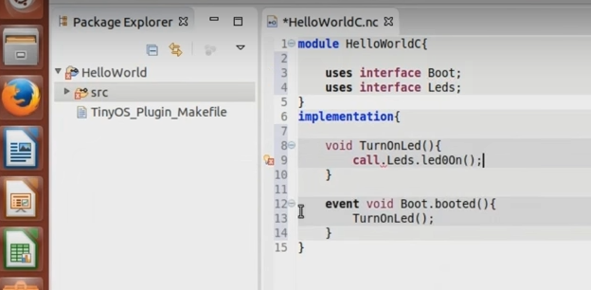
Component Model of TinyOS

Slide 10
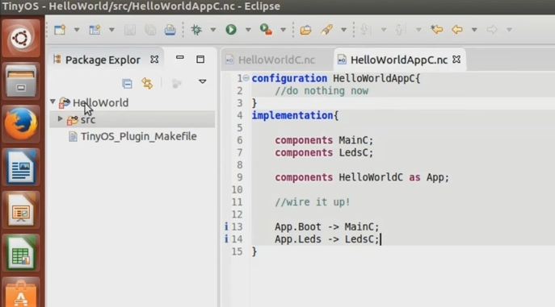
Component Model of TinyOS

Slide 11
Component Model
Interfaces
TinyOS’s programming model, provided by the NesC language, centers around the notion of components that encapsulate a specific set of services, specified by interfaces.
TinyOS itself simply consists of a set of reusable system components along with a task scheduler.
An application connects components using a wiring specification that is independent of component implementations.
This wiring specification(configuration file) defines the complete set of components that the application uses.
The interfaces define how the component directly interacts with other components.
A component has two classes of interfaces: those it provides and those it uses.

Slide 12
Four broad requirements motivate the design of TinyOS
Limited resources:
Motes(wireless hardware devices) have very limited physical resources, due to the goals of small size, low cost, and low power consumption.
Current motes consist of about a 1-MIPS processor and tens of kilobytes of storage
We do not expect new technology to remove these limitations: But the benefits like reduce size and cost.

Slide 13
Four broad requirements motivate the design of TinyOS
2. Reactive Concurrency:
In a typical sensor network application, a node is responsible for sampling aspects of its environment through sensors, perhaps manipulating it through actuators, performing local data processing, transmitting data, routing data for others, and participating in various distributed processing tasks, such as statistical aggregation or feature recognition.
Many of these events, require real-time responses. This requires an approach to concurrency management that reduces potential bugs while respecting resource and timing constraints

Slide 14
Four broad requirements motivate the design of TinyOS
3.Flexibility:
The variation in hardware and applications and the rate of innovation require a flexible OS that is both application-specific to reduce space and power, and independent of the boundary between hardware and software.
In addition, the OS should support fine-grain modularity and inter positioning to simplify reuse and innovation.

Slide 15
Four broad requirements motivate the design of TinyOS
4. Low Power:
Demands of size and cost, as well as low-power operation are the key goal of mote design.
Battery density doubles roughly every 50 years, which makes power an ongoing challenge. Although energy harvesting offers many promising solutions, at the very small scale of motes we can harvest only microwatts of power.
This is insufficient for continuous operation of most energy-efficient designs. Given the broad range of applications for sensor networks, TinyOS must not only address extremely low-power operation, but also provide a great deal of flexibility in power-management

